Slide 1
Protocol Stack and Connecting Technology

Slide 2
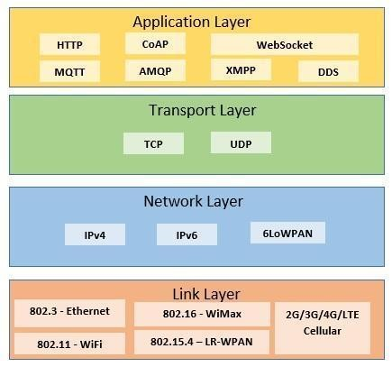
IoT Protocol Stack

Slide 3
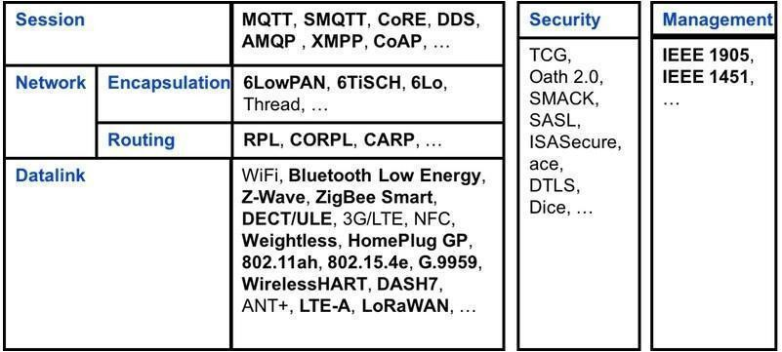
IoT Protocol for each Layer

Slide 4
IoT Protocol
Application and Session Layer Protocol | MQTT | MQTT is a commonly used light-weight communication protocol for communication among clients and servers.
 | SMQTT | A secure MQTT provides encryption for message transfer.
 | MQTT-SN | MQTT-SN is an extension of MQTT for sensor networks.
 | CoAP | CoAP is a web transfer protocol for constrained networks of IoT.
 | DDS | DDS is a data connectivity protocol among IoT nodes and API.
 | XMPP | XMPP is a client-server communication protocol using XML elements.
 | RESTful/HTTP | RESTful/HTTP is a web connection protocol with state information.
 | Websocket | Websocket is a communication protocol for data transmission among multiple nodes.
 | SOAP | SOAP is a communication protocol used with HTTP and XML.

Slide 5
IoT Protocol
 | Transport Layer Protocol | TCP | TCP is a connection-oriented transport protocol with optimal functionality used for MQTT operations.
 |  | UDP | UDP is a web connectionless transport protocol for resource-constrained devices.
 | Network Layer Protocol | IPv4 | IPv4 is used to provide a unique identity to each connected node.
 |  | IPv6 | IPv6 is used to provide multiple identities to each connected node.
 |  | 6LoWPAN | 6LoWPAN is used for the connection of wireless IoT devices.
 | Data Link Layer Protocol | 802.3 – Ethernet | It provides a connection to the stationary IoT devices.
 |  | 802.16 – WiMax | 802.3 - Ethernet is used for the high-speed data rate wireless connection of IoT devices.
 |  | 802.11 –WiFi | 802.11 -WiFi provides a wireless LAN connection to IoT nodes.
 |  | 802.15.4 -LR-WPAN | 802.15.4 -LR-WPAN is used for wireless sensor networks that have IPv6 addresses.
 |  | Wifi | Wifi uses radio frequency to communicate among IoT nodes.

Slide 6
IoT Protocol
Data Link Layer Protocol | Bluetooth Low Energy (BLE) | BLE is used for IoT devices to communicate with other connected nodes.
 | ZigBee | ZigBee is a wireless technology for local communication.
 | Z-Wave | Z-Wave is a wireless technology for communication in the M2M network.
 | WirelessHART | WirelessHART provides synchronization of connected devices of the network using TDMA.
 | DASH7 | DASH7 provides bi-directional communication for the sensor-actuator network.

Slide 7
IoT Protocol List
Connectivity (6LowPAN, RPL)
Identiﬁcation (EPC, uCode, IPv6, URIs)
Communication / Transport (WiFi, Bluetooth, LPWAN)
Discovery (Physical Web, mDNS, DNS‐SD)
Data Protocols (MQTT, CoAP, AMQP, Websocket, Node)
Device Management (TR‐069, OMA‐DM)
Semantic (JSON‐LD, Web Thing Model)
Multi‐layer Frameworks (Alljoyn, IoTivity, Weave, Homekit)

Slide 8
6LoWPAN
Low‐power Wireless Personal Area Networks over IPv6.
Allows for the smallest devices with limited processing ability to transmit information wirelessly using an Internet protocol.
Allows low‐power devices to connect to the Internet.
Created by the Internet Engineering Task Force (IETF) ‐ RFC 5933 and RFC 4919.

Slide 9
Features of 6LoWPAN
Allows IEEE 802.15.4 radios to carry 128 ‐bit addresses of Internet Protocol version 6 (IPv6).
Header compression and address translation techniques allow the IEEE
802.15.4 radios to access the Internet.
IPv6 packets compressed and re-formatted to ﬁt the IEEE 802.15.4 packet format.
Uses include IoT, Smart grid, and M2M applications.

Slide 10
6LoWPAN Routing and Addressing
Mesh routing within the PAN space.
Routing between IPv6 and the PAN domain
Routing protocols in use:
LOADng
RPL
Addressing
64‐bit addresses: globally unique
16 bit addresses: PAN speciﬁc; assigned by PAN coordinator
IPv6 multicast not supported by 802.15.4
IPv6 packets carried as link layer broadcast frames

Slide 11
Advantages of 6LoWPAN
6LoWPAN is a mesh network that is robust, scalable, and can heal on its own.
It delivers low-cost and secure communication in IoT devices.
It uses IPv6 protocol and so it can be directly routed to cloud platforms.
It offers one-to-many and many-to-one routing.
In the network, leaf nodes can be in sleep mode for a longer duration of time.

Slide 12
Disadvantages of 6LoWPAN
It is comparatively less secure than Zigbee.
It has lesser immunity to interference than that Wi-Fi and Bluetooth.
Without the mesh topology, it supports a short range.

Slide 13
Application of 6LoWPAN
It is a wireless sensor network.
It is used in home-automation,
It is used in smart agricultural techniques, and industrial monitoring.
It is utilised to make IPv6 packet transmission on networks with constrained power and reliability resources possible.

Slide 14
Security and Interoperability of 6LoWPAN
Security: 6LoWPAN security is ensured by the AES algorithm, which is a link layer security, and the transport layer security mechanisms are included as well.
Interoperability: 6LoWPAN is able to operate with other wireless devices as well which makes it interoperable in a network.

Slide 15
RFID
RFID is an acronym for “radio‐frequency identiﬁcation”
Data digitally encoded in RFID tags, which can be read by a reader.
Somewhat similar to barcodes.
Data read from tags are stored in a database by the reader.
As compared to traditional barcodes and QR codes, RFID tag data can be read outside the line‐of‐sight.

Slide 16
RFID Features
RFID tag consists of an integrated circuit and an antenna.
The tag is covered by a protective material which also acts as a shield against various environmental eﬀects.
Tags may be passive or active.
Passive RFID tags are the most widely used.
Passive tags have to be powered by a reader inductively before they can transmit information, whereas active tags have their own power supply.

Slide 17
RFID Working
Derived from Automatic Identiﬁcation and Data Capture (AIDC) technology.
AIDC performs object identiﬁcation, object data collection and mapping of the collected data to computer systems with little or no human intervention.
AIDC uses wired communication
RFID uses radio waves to perform AIDC functions.
The main components of an RFID system include an RFID tag or smart label, an RFID reader, and an antenna.

Slide 18
RFID Applications
Inventory management
Asset tracking
Personnel tracking
Controlling access to restricted areas
ID badging
Supply chain management
Pharmaceutical industry

Slide 19
MQTT
Message Queue Telemetry Transport.
ISO standard (ISO/IEC PRF 20922).
It is a publish‐subscribe‐based lightweight messaging protocol for use in conjunction with the TCP/IP protocol.
MQTT was introduced by IBM in 1999 and standardized by OASIS in 2013.
Designed to provide connectivity (mostly embedded) between applications and middle‐wares on one side and networks and communications on the other side.

Slide 20
MQTT
A message broker controls the publish‐subscribe messaging pattern.
A topic to which a client is subscribed is updated in the form of messages and distributed by the message broker.
Designed for:
Remote connections
Limited bandwidth
Small‐code footprint

Slide 21
MQTT Components
Publishers
Lightweight sensors
Subscribers
Applications interested in sensor data
Broker
Connect publishers and subscribers
Classify sensor data into topics

Slide 22
MQTT Methods
Connect
Disconnect
Subscribe
Unsubscribe
Publish

Slide 23
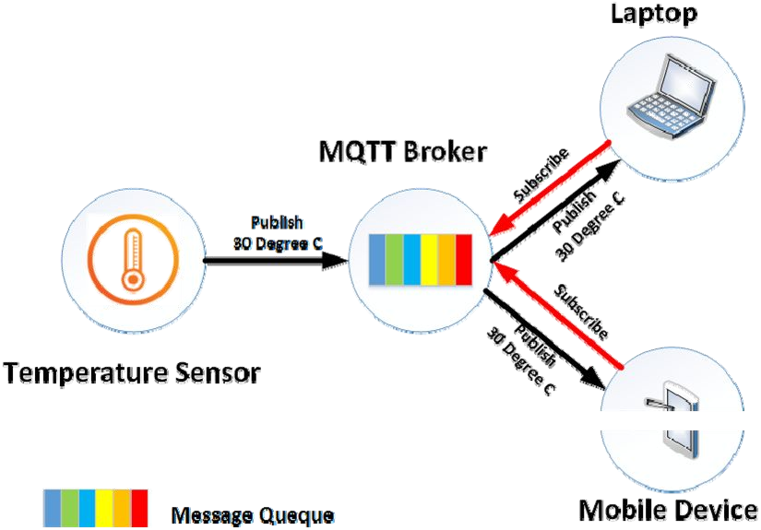
MQTT Communication Model

Slide 24
MQTT Communication
The protocol uses a publish/subscribe architecture (HTTP uses a request/response paradigm).
Publish/subscribe is event‐driven and enables messages to be pushed to clients.
The central communication point is the MQTT broker, which is in charge of dispatching all messages between the senders and the rightful receivers.
Each client that publishes a message to the broker, includes a topic into the message. The topic is the routing information for the broker.

Slide 25
MQTT Communication
Each client that wants to receive messages subscribes to a certain topic and the broker delivers all messages with the matching topic to the client.
Therefore the clients don’t have to know each other. They only communicate over the topic.
This architecture enables highly scalable solutions without dependencies between the data producers and the data consumers.

Slide 26
MQTT Topic
A topic is a simple string that can have more hierarchy levels, which are separated by a slash.
A sample topic for sending temperature data of the living room could be house/living‐room/temperature.
On one hand the client (e.g. mobile device) can subscribe to the exact topic or on the other hand, it can use a wildcard.

Slide 27
MQTT Topic
The subscription to house/+/temperature would result in all messages sent to the previously mentioned topic house/livingroom/ temperature, as well as any topic with an arbitrary value in the place of living room, such as house/kitchen/temperature.
The plus sign is a single level wild card and only allows arbitrary values for one hierarchy.
If more than one level needs to be subscribed, such as, the entire sub‐tree, there is also a multilevel wildcard (#).
It allows to subscribe to all underlying hierarchy levels.
For example house/# is subscribing to all topics beginning with house.

Slide 28
Applications
Facebook Messenger uses MQTT for online chat.
Amazon Web Services use Amazon IoT with MQTT.
Microsoft Azure IoT Hub uses MQTT as its main protocol for telemetry messages.
The EVRYTHNG IoT platform uses MQTT as an M2M protocol for millions of connected products.
Adafruit launched a free MQTT cloud service for IoT experimenters called Adafruit IO.

Slide 29
SMQTT
Secure MQTT is an extension of MQTT which uses encryption based on lightweight attribute.
The main advantage of using such encryption is the broadcast encryption feature, in which one message is encrypted and delivered to multiple other nodes, which is quite common in IoT applications.
In general, the algorithm consists of four main stages: setup, encryption, publish and decryption.

Slide 30
SMQTT
In the setup phase, the subscribers and publishers register themselves to the broker and get a master secret key according to their developer’s choice of key generation algorithm.
When the data is published, it is encrypted and published by the broker which sends it to the subscribers, which is ﬁnally decrypted at the subscriber end having the same master secret key.
The key generation and encryption algorithms are not standardized.
SMQTT is proposed only to enhance MQTT security features.

Slide 31
CoAP
CoAP – Constrained Application Protocol.
Web transfer protocol for use with constrained nodes and networks.
Designed for Machine to Machine (M2M) applications such as smart energy and building automation.
Based on Request‐Response model between end‐points
Client‐Server interaction is asynchronous over a datagram oriented transport protocol such as UDP

Slide 32
Where are we?
We are here!
HTTP, Websockets, DNS, XMPP, MQTT, CoAp | Application layer
TLS, SSL | Application Layer (Encryption)
TCP, UDP | Transport
IP(V4, V6), 6LowPAN | Internet Layer
Ethernet, 802.11 WiFi, 802.15.4 | Link Layer

Slide 33
The Constrained Application Protocol (CoAP) is a session layer protocol designed by IETF Constrained RESTful Environment (CoRE) working group to provide lightweight RESTful (HTTP) interface.
Representational State Transfer (REST) is the standard interface between HTTP client and servers.
Lightweight applications such as those in IoT, could result in signiﬁcant overhead and power consumption by REST.
CoAP is designed to enable low‐power sensors to use RESTful services while meeting their power constraints.

Slide 34
Built over UDP, instead of TCP (which is commonly used with HTTP) and has a light mechanism to provide reliability.
CoAP architecture is divided into two main sub‐layers:
Messaging
Request/response.
The messaging sub‐layer is responsible for reliability and duplication of
messages, while the request/response sublayer is responsible for
communication.
CoAP has four messaging modes:
Conﬁrmable
Non‐conﬁrmable
Piggyback
Separate

Slide 35



Constrained Application Protocol (CoAp)
Who uses or supports CoAP?
- Open Mobile Alliance M2M
- IPSO Alliance (IP for Smart Objects)
- European Telecom Standards Institute M2M / OneM2M
- Lighting systems for smart cities
- Device management for network operators.
- Copper is a Firefox plugin – treat devices as REST services
- Main Java project on github : Californium

Slide 36
CoAP
Has a scheme coap://
Has a well known port.
GET, POST, PUT, DELETE encoded in binary ( 1 == GET)
Block transfer support.
Confirmable messages requires an ACK with message ID. The message ID of the ACK matches the message ID of the confirmable message.
Non-confirmable messages do not require an ACK. Less reliable.
Responses are matched with requests via the client generated Token.
Example:
CoAP Client CoAP Server
----> CON {id} GET /basement/light Confirmable request has an ID
<---- ACK {id} 200 Content {“status” : “on”} Piggy back response and same ID

Slide 37
CoAP Uses Timeouts over UDP
CoAP Client CoAP Server
----> CON {id} GET /basement/light lost request
timeout -- --> CON {id} GET /basement/light finally arrives
<---- ACK {id} 200 Content {“status” : “on”}
The {id} allows us to detect duplicates.
What happens if the ACK is also lost?

Slide 38
CoAP Request/Acknowledge/Callback
CoAP Client CoAP Server
----> CON {id} PUT /basement/cleanFloor Token: 0x22 Needs time
<---- ACK {id} I am on it!
<----- CON {newID} 200 Content /basement/cleanFloor Token: 0x22 Done
----> ACK {newID}
In this example, the same token is used to identify this request and the service response. The id’s are used at the message level.

Slide 39
CoAP Publish/Subscribe
The GET includes an “Observe” message to establish a subscription request.
The response includes an “Observe” to say this is a publication.
The value included with Observe response is there for possible re-orderings. The client
should take the most recent sent and not the most recent to arrive.
CoAP Client CoAP Server
----> CON {id} GET /basement/light Observe: 0 Token: 0x22
<---- ACK 200 {id} Observe: 27 Token 0x22
<---- CON 200 Observe: 28 Token: 0x22 {“light” : ”off”}
-----> ACK Token: 0x22
<---- CON 200 Observe: 30 Token: 0x22 {“light” : ”on”}
:
:
etc.
Block transfer is similar. We may request a transfer (one block at a time).

Slide 40
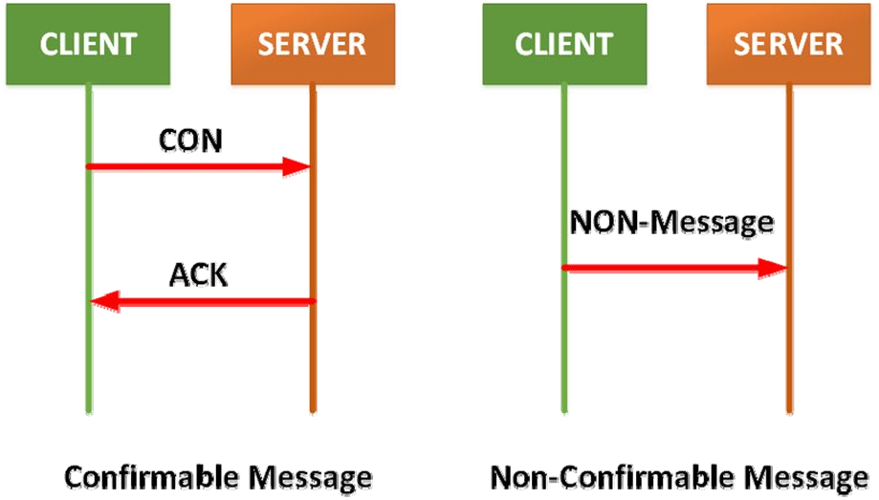
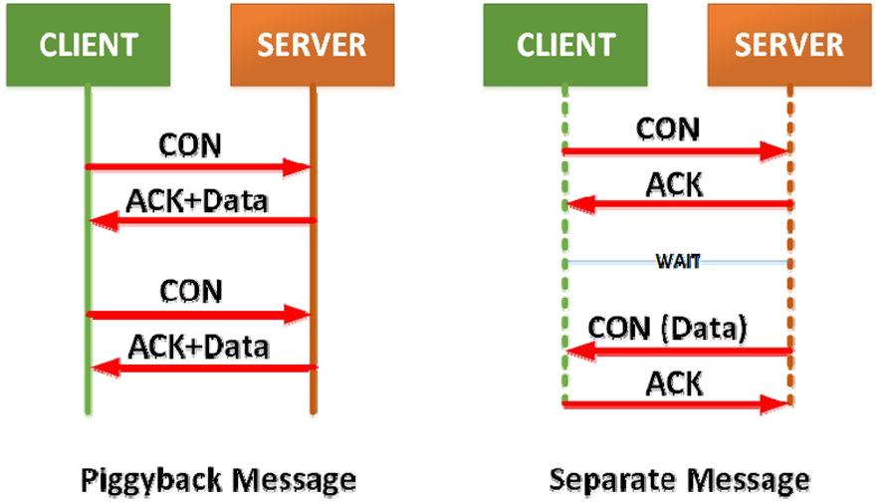
CoAP Request Response Model

Slide 41
Features
Reduced overheads and parsing complexity.
URL and content‐type support.
Support for the discovery of resources provided by known CoAP services.
Simple subscription for a resource, and resulting push notiﬁcations.
Simple caching based on maximum message age.

Slide 42
XMPP
XMPP – Extensible Messaging and Presence Protocol.
A communication protocol for message‐oriented middleware based on XML (Extensible Markup Language).
Real‐time exchange of structured data.
It is an open standard protocol.

Slide 43
XMPP
XMPP uses a client‐server architecture.
As the model is decentralized, no central server is required.
XMPP provides for the discovery of services residing locally or across a network, and the availability information of these services.
Well‐suited for cloud computing where virtual machines, networks, and ﬁrewalls would otherwise present obstacles to alternative service discovery and presence‐based solutions.
Open means to support machine‐to‐machine or peer‐to‐peer communications across a diverse set of networks.

Slide 44
Features
Decentralization – No central server; anyone can run their own XMPP server.
Open standards – No royalties or granted permissions are required to implement these speciﬁcations
Security – Authentication, encryption, etc.
Flexibility – Supports interoperability

Slide 45
Application
Publish‐subscribe systems
Signaling for VoIP
Video
File transfer
Gaming
Smart grid
Social networking services

Slide 46
Weakness
Does not support QoS.
Text based communications induces higher network overheads.
Binary data must be ﬁrst encoded to base64 before transmission.

Slide 47
AMQP
Advanced Message Queuing Protocol.
Open standard for passing business messages between applications or organizations.
Connects between systems and business processes.
It is a binary application layer protocol.
Basic unit of data is a frame.
ISO standard: ISO/IEC 19464

Slide 48
Features
Security
Reliability
Interoperability
Routing
Queuing
Open standard

Slide 49
QoS
At‐most‐once
each message is delivered once or never
At‐least‐once
each message is certain to be delivered, but may do so multiple times
Exactly‐once
message will always certainly arrive and do so only once

Slide 50
Application
Monitoring and global update sharing.
Connecting diﬀerent systems and processes to talk to each other.
Allowing servers to respond to immediate requests quickly and delegate time consuming tasks for later processing.
Distributing a message to multiple recipients for consumption.
Enabling oﬄine clients to fetch data at a later time.
Introducing fully asynchronous functionality for systems.
Increasing reliability and uptime of application deployments.

Slide 51
Communication at Data link Layer
IEEE 802.15.4
Zigbee
6LoWPAN
Wireless HART
Z‐Wave
ISA 100
Bluetooth
NFC
RFID

Slide 52
IEEE 802.15.4
Well‐known standard for low data‐rate WPAN.
Developed for low‐data‐rate monitoring and control applications and extended‐life low‐power‐consumption uses.
This standard uses only the ﬁrst two layers (PHY, MAC) plus the logical link control (LLC) communicate with all upper layers

Slide 53
Bluetooth
Bluetooth wireless technology is a short range communications technology.
Intended for replacing cables connecting portable units
Maintains high levels of security.
Bluetooth technology is based on Ad‐hoc technology also known as Ad‐hoc Piconets.

Slide 54
Bluetooth Features
Bluetooth technology operates in the unlicensed industrial scientiﬁc and medical (ISM) band at 2.4 to 2.485 GHZ.
Uses spread spectrum hopping, full‐duplex signal at a nominalrate of 1600
hops/sec.
Bluetooth supports 1Mbps data rate for version 1.2 and 3Mbps data rate for
Version 2.0 combined with Error Data Rate.
Bluetooth operating range depends on the device:
Class 3 radios have a range of up to 1 meter or 3 feet
Class 2 radios are most commonly found in mobile devices have a range of 10 meters or 30 feet
Class 1 radios are used primarily in industrial use cases have a range of 100 meters or 300 feet.

Slide 55
Connection Establishment
Inquiry:
Inquiry run by one Bluetooth device to try to discover other devices near it.
Paging:
Process of forming a connection between two Bluetooth devices.
Connection:
A device either actively participates in the network or enters a low‐power sleep mode.
Modes of Connection:
Active: Actively transmitting or receiving data.
Sniﬀ: Sleeps and only listens for transmissions at a set interval
Hold: Power‐saving mode where a device sleeps for a deﬁned period and then returns back to active mode
Park: Slave will become inactive until the master tells it to wake back up.

Slide 56
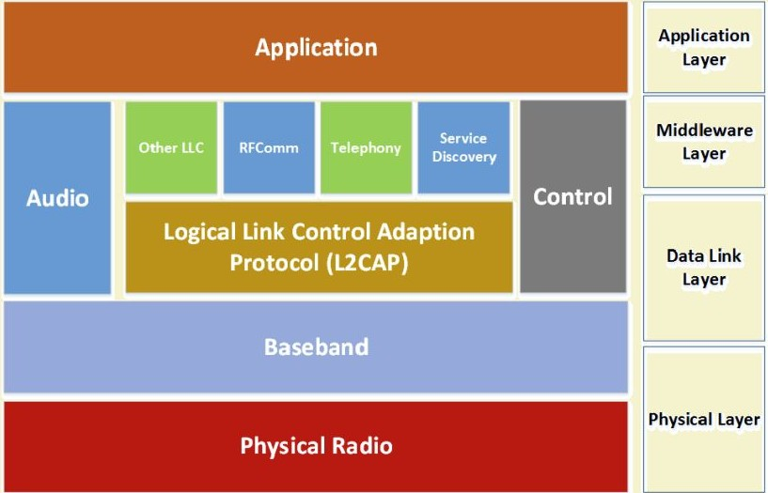
Bluetooth Protocol Stack

Slide 57
Bluetooth Protocol Stack
Baseband:
Physical layer of the Bluetooth.
Manages physical channels and links.
Other services include:
Error correction
Data whitening
Hop selection
Bluetooth security
Manages asynchronous and synchronous links.
Handles packets, paging and inquiry.
L2CAP
The Logical Link Control and Adaptation Protocol (L2CAP).
Layered over the Baseband Protocol and resides in the data link layer.
Used to multiplex multiple logical connections between two devices.
Provides connection‐oriented and connectionless data services to upper layer
protocols.
Provides:
Protocol multiplexing capability
Segmentation and reassembly operation

Slide 58
Bluetooth Protocol Stack
RFComm
Radio Frequency Communications (RFCOMM).
It is a cable replacement protocol used for generating a virtual serial data stream.
RFCOMM provides for binary data transport .
RFCOMM provides a simple reliable data stream to the user, similar to TCP.
Supports up to 60 simultaneous connections between two devices.
Service Discovery Protocol (SDP)
Enables applications to discover available services and their features.
Addresses the unique characteristics of the Bluetooth environment such as, dynamic changes in the quality of services in RF proximity of devices in motion.
Can function over a reliable packet transfer protocol.
Uses a request/response model.

Slide 59
Piconets
Piconets
Bluetooth enabled electronic devices connect and communicate wirelessly through short range networks known as Piconets.
Bluetooth devices exist in small ad‐hoc conﬁgurations with the ability to act either as master or slave.
Provisions are in place, which allow for a master and a slave to switch their roles.
The simplest conﬁguration is a point to point conﬁguration with one master and one slave.
When more than two Bluetooth devices communicate with one another, it is called a PICONET.
A Piconet can contain up to seven slaves clustered around a single master.
The device that initializes establishment of the Piconet becomes the master.
The master is responsible for transmission control by dividing the network into a series of time slots amongst the network members, as a part of time division multiplexing scheme.
There is no direct connection between the slaves.
A device can be a member of two or more Piconets.

Slide 60
Zigbee
Most widely deployed enhancement of IEEE 802.15.4.
The ZigBee protocol is deﬁned by layer 3 and above. It works with the
802.15.4 layers 1 and 2.
The standard uses layers 3 and 4 to deﬁne additional communication enhancements.
These enhancements include authentication with valid nodes, encryption for security, and a data routing and forwarding capability that enables mesh networking.
The most popular use of ZigBee is wireless sensor networks using the mesh topology.

Slide 61
Zigbee Applications
Building automation
Remote control (RF4CE or RF for consumer electronics)
Smart energy for home energy monitoring
Health care for medical and ﬁtness monitoring
Home automation for control of smart homes
Light Link for control of LED lighting
Telecom services

Slide 62
ZWave
Zwave is a protocol for communication among devices used for home automation.
It uses RF for signaling and control.
Mesh network topology is the main mode of operation, and can
support 232 nodes in a network.
A central network controller device sets‐up and manages a Zwave network.
Each logical Zwave network has 1 Home (Network) ID and multiple
node IDs for the devices in it.
Nodes with diﬀerent Home IDs cannot communicate with each other.
Network ID length=4 Bytes, Node ID length=1 Byte.

Slide 63
ZWave
Uses source routed network mesh topology using 1 primary controller.
Devices communicate with one another when in range.
When devices are not in range, messages are routed through diﬀerent nodes to bypass obstructions created by household appliances or layout.
This process of bypassing radio dead‐spots is done using a message called Healing.
As Zwave uses a source routed static network, mobile devices are excluded from the network and only static devices are considered.

Slide 64
Zwave vs Zigbee
Zwave | Zigbee
User friendly and provides a simple system that users can set up themselves. Ideal for someone with a basic understanding of technology who wants to keep their home automation secure, efficient,simple to use, and easy to maintain. Expensive. Nine out of ten leading security and communication companies in the U.S. use ZWave in their smart home solutions | Requires so little power that devices can last up to seven years on one set of batteries. Ideal for technology experts who want a system they can customize with their preferences and install themselves. Cheaper than Zwave. ZigBee Alliance consists of nearly 400 member organizations that use, develop, and improve ZigBee’s open-standard wireless connection

